Slide 1
Lecture 4 – Finite State Machine
By Dr. Jonathan Valvano
Modified by Dr. Min He

Slide 2
Outline
  Finite State Machines
  Moore FSM
  Model Traffic Light Controller
  Implement Traffic Light Controller

Slide 3
Finite State Machine (FSM)
Set of inputs, outputs, states and transitions
  Inputs (sensors)
  Outputs (actuators)
  State: Description of current conditions
  Controller/Engine: Software that inputs, outputs, changes state
  Tools to defines input/output relationship: State Table and State graph

Slide 4
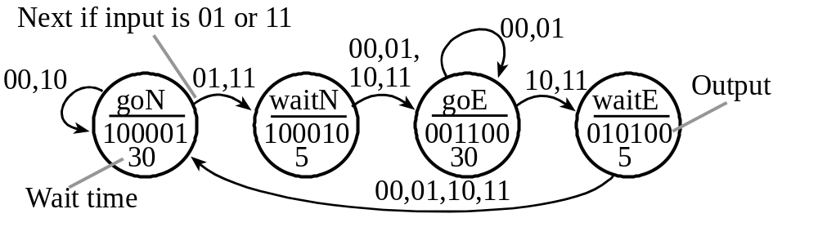
Moore FSM
Output value depends only on the current state,
Inputs affect the state transitions
Significance is being in a state

Slide 5
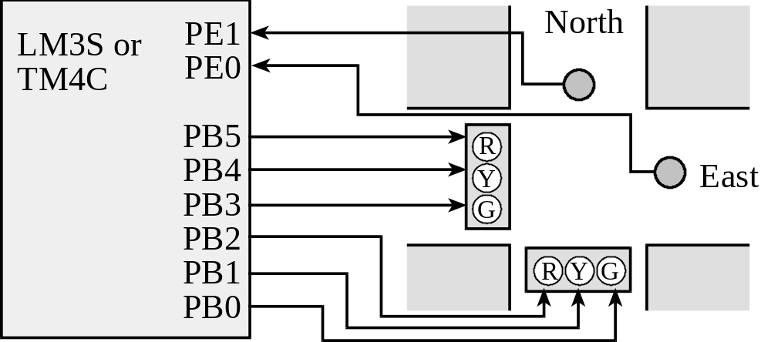
Traffic Light Control
PE1=0, PE0=0 means no cars exist on either road
PE1=0, PE0=1 means there are cars on the East road
PE1=1, PE0=0 means there are cars on the North road
PE1=1, PE0=1 means there are cars on both roads
goN, PB5-0 = 100001 makes it green on North and red on East
waitN, PB5-0 = 100010 makes it yellow on North and red on East
goE, PB5-0 = 001100 makes it red on North and green on East
waitE, PB5-0 = 010100 makes it red on North and yellow on East

Slide 6
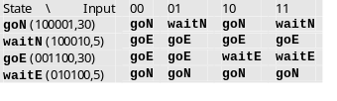
Model Traffic Light with State Graph and State Table

Slide 7
Moore FSM Engine:
Execution Sequence
  Perform output corresponding to the current state
  Wait a prescribed amount of time (optional)
  Read inputs
  Change state, which depends on the input and the current state
  Go back to 1. and repeat

Slide 8
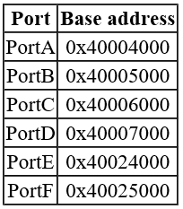
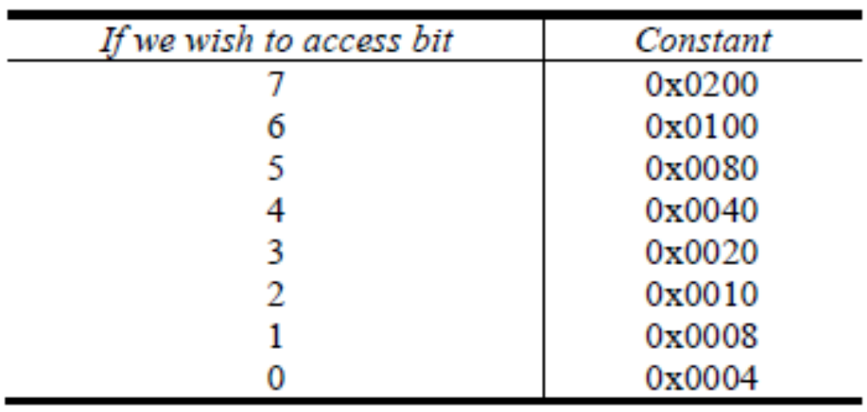
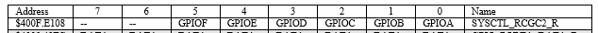
Input/Output Setup
#define SENSOR (*((volatile unsigned long *)0x4002400C))
// PE1, PE0 connect to the two sensor
#define LIGHT (*((volatile unsigned long *)0x400050FC))
// PB0 to PB5 are used for traffic lights
SYSCTL_RCGC2_R |= 0x12; // 1) use port B E

Slide 9
FSM Data Structure in C (Indexes)
const struct State {
uint32_t Out;
uint32_t Time; // 10 ms units
uint32_t Next[4]; // list of next states
};
typedef const struct State STyp;
#define goN 0
#define waitN 1
#define goE 2
#define waitE 3
STyp FSM[4] = {
{0x21,3000,{goN,waitN,goN,waitN}},
{0x22, 500,{goE,goE,goE,goE}},
{0x0C,3000,{goE,goE,waitE,waitE}},
{0x14, 500,{goN,goN,goN,goN}}
};
In ROM

Slide 10
FSM Engine in C (Indexes)
void main(void) {
uint32 CS; // index of current state
uint32_t Input;
// initialize ports and timer
…
CS = goN; // start state
while(1) {
LIGHT = FSM[CS].Out; // set lights
SysTick_Wait10ms(FSM[CS].Time);
Input = SENSOR; // read sensors
CS = FSM[CS].Next[Input];
}
}

Slide 11
Reference
Chapter 6: 6.1 – 6.6
Example projects:
C10_TableTrafficLight
C10_VendingMachine
C10_StepperRobot
C10_LineTracker

